Slide 1
RAC System
Sponsors: Alain Beauparlant
Team Members:
Brae Walker
Andrew Ha
Cody Berube
Louis Thibodeau
Philip Dumaresq
Maxwell Haley
Notes:
Project name – pick a cool sounding name for your project
Sponsors – list your project sponsors here (the people with the money)
Putting your sponsors name boldly out there for all to see is a great way to get their engagement and attention (necessary for any successful project).

Slide 2
The elevator pitch
For Alain Beauparlant
who needs to replace the paper system
the new RAC System
is a web application
that will allow people to complete RAC requests online.
Unlike the current paper system
our product is very easily accessible and the process can be completed any time and anywhere.
Notes:
Change the green text to apply to the system to be developed. Remove the square brackets and change all text in the list to be black.

Slide 3
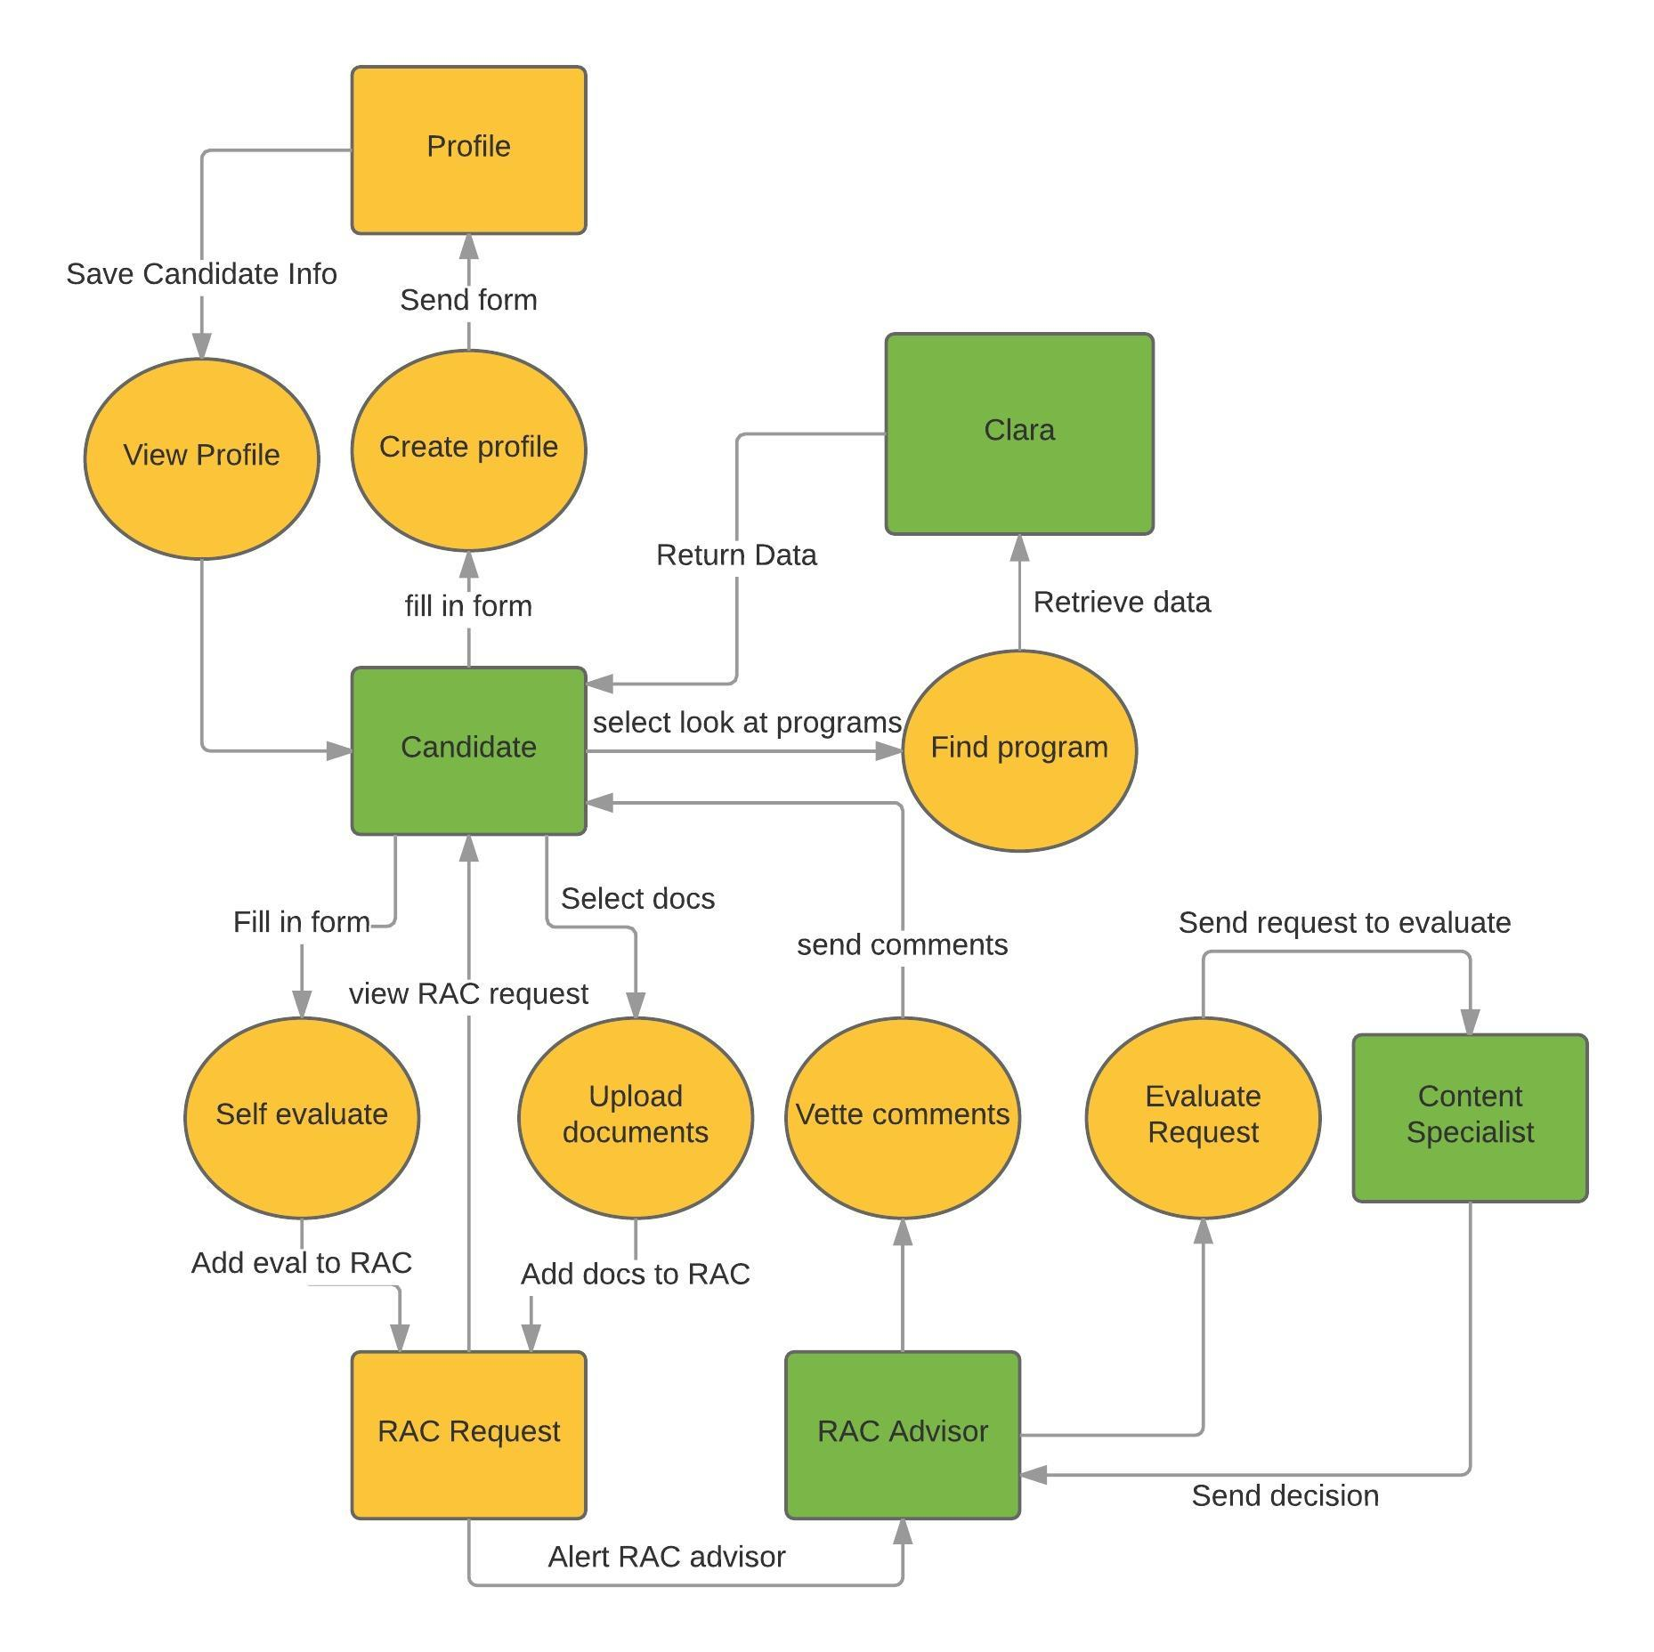
System context
Notes:
Include the context diagram here

Slide 4
The NOT list
IN | OUT
Technical Research | Update Account
Candidate Create/Retrieve account info | Candidate Update/delete account info
Candidate choose program | Candidate view previous RAC requests
Candidate upload documents / self assess | Captivating look and feel
Candidate Submit RAC request | RAC advisor – CRUD candidate accounts
RAC advisor – Read RAC requests | Content specialist flow
UNRESOLVED
RAC advisor - Notification
Notes:
List all the big ticket items you are (and are NOT) going to deliver within the scope of this project.
Before starting your project move all the UNRESOLVED ones to either IN or OUT.

Slide 5

Technical solution
Clara
IIS
SQL
Alain Beauparlant
SQL server
SQL
Technologies:
C#, JavaScript
Visual Studio, SQL Server
MVC, Entity Framework
Notes:
This is about letting people know how we plan on building this thing.
If there are any tools or libraries assumptions you are making list them here.
Also if there are areas of the application architecture that are risky highlight those too.

Slide 6

What keeps us up at night
Brae’s concussion
The team’s organization
Levels of communication
Notes:
This is your chance to call out any craziness you’ve heard while building the deck, and having a frank conversation with your sponsors and your team about how you are going to handle it.
This is perhaps on of the most powerful slides in the deck – it’s your chance to ask for whatever you need to be successful and the consequences if you don’t get it.
Use it!

Slide 7

How big is this thing?
Ship it!
Construction
UAT
Training
7 Months
2 Months
1 wk
This is a guess. Not a commitment.
Notes:
Give your sponsors some idea of how big this thing is (1, 3, or 6 monther).
Before you can complete this slide you and the team should create and estimate a high-level story list for the project.
This isn’t a commitment (too many unknowns). It’s just a really rough guess. Don’t treat it as anything else.

Slide 8
Release 1 – December Demo
By the December release we’d like to have an initial prototype working that contains the bare necessities for the beginning of the system flow. This includes the ability to:
Create a candidate account
Browse through programs and competencies
Self-evaluate and upload documents for a RAC request
RAC advisor can view requests
RAC advisor receives notifications
Notes:
Give your sponsors some idea of what you’ll be able to demonstrate in December assuming you have 2 sprints to put into this.

Slide 9
Trade-off sliders
 | The classic four
 | Feature completeness (scope)
 | Stay within budget (budget)
 | Deliver project on time (time)
 | High quality, low defects (quality)
OFF
ON
OFF
ON
OFF
ON
OFF
ON
 | Other important things
 | Ease of use
OFF
ON
Notes:
When push comes to shove, something has to give. Here we want to be clear on what that is.
On agile projects we flex on scope. But there could be others factors at play here so get ready to listen as you customer tells you which forces can bend (scope) and which are written in stone (usually budget).
Slider rules:
1. No two sliders can occupy the same level.
2. List other important project factors down below.

Slide 10

Reference
http://agilewarrior.wordpress.com
Notes:
That’s it! Create your deck.
Put it somewhere visible for all too see.
And update it when things change.
Good luck!

